Slide 1
Animal Development

Slide 2
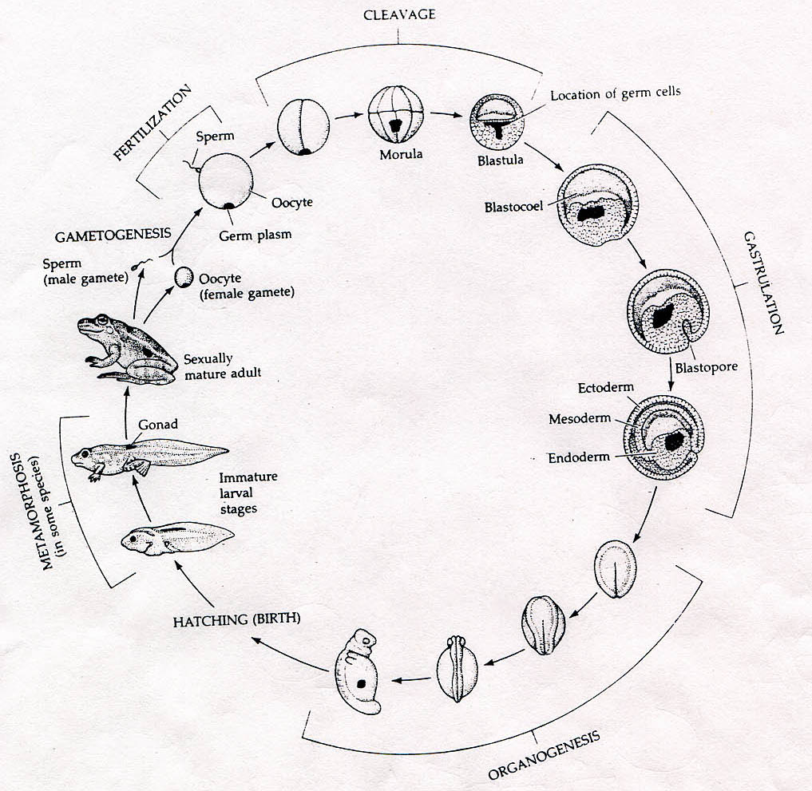
What are the mechanisms that make an egg to generate a great diversity of cell types?

Slide 3
The development of specialized cell types by a single fertilized egg is called differentiation

Slide 4
How does a fertilized egg generate a great diversity of cell types
1) Different Genome
    2) The same genome express different sets
    of genes in different cell types
3) Localized Cytoplasm determinants

Slide 5
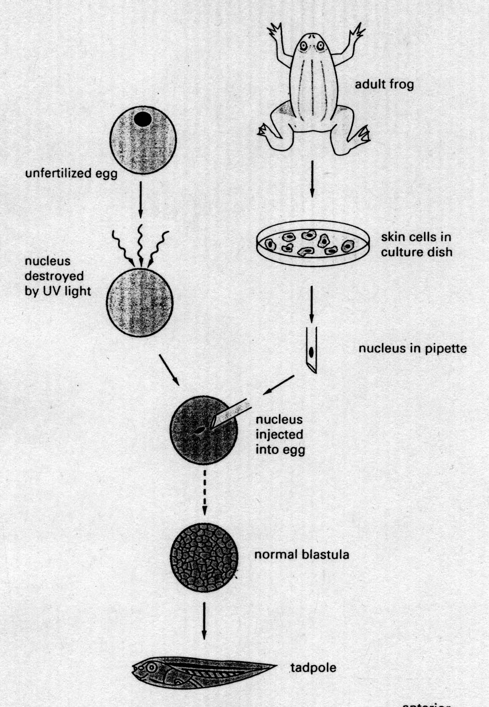
Transplantation experiment

Slide 6

What does this transplantation experiment tell you?
Localized cytoplasm determinants are important
The genome stays the same during cell differentiation
Skin cells have the potential to generate all cell types
You don’t really need nuclei for cell differentiation
None of above

Slide 7
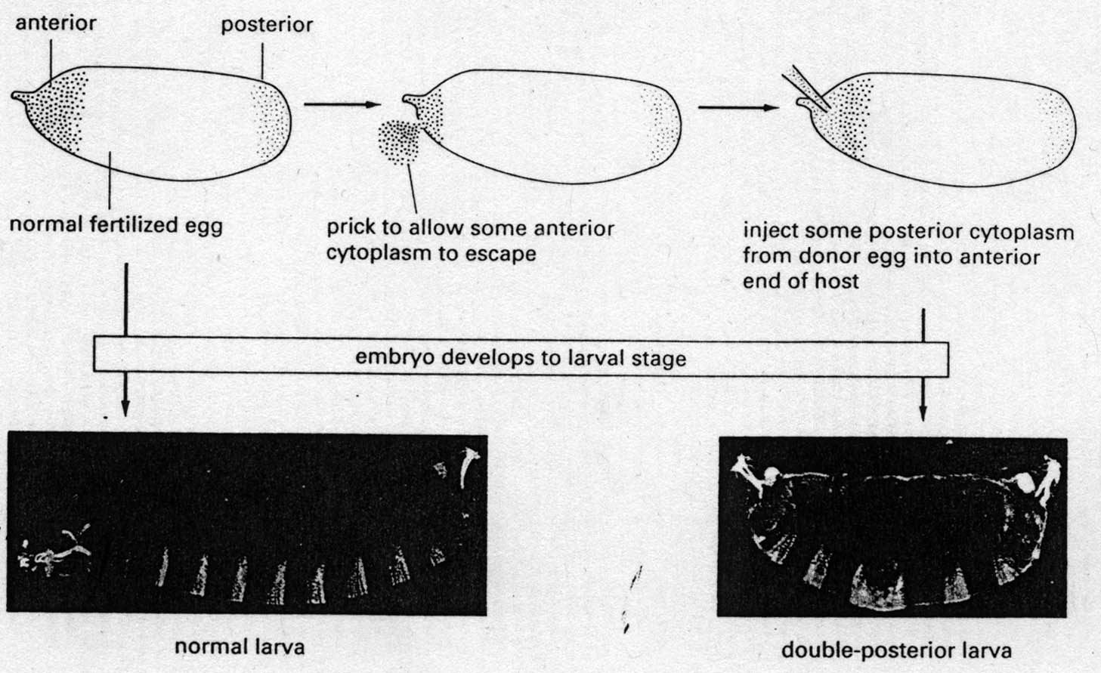

Slide 8
What does this transplantation experiment tell you?
Cytoplasmic determinants are different in the anterior and posterior regions
The genome is different in the anterior and posterior regions
The anterior region is damaged by pricking. So it differentiates like the posterior region
The anterior region sometimes can just fail to differentiate properly
None of above

Slide 9
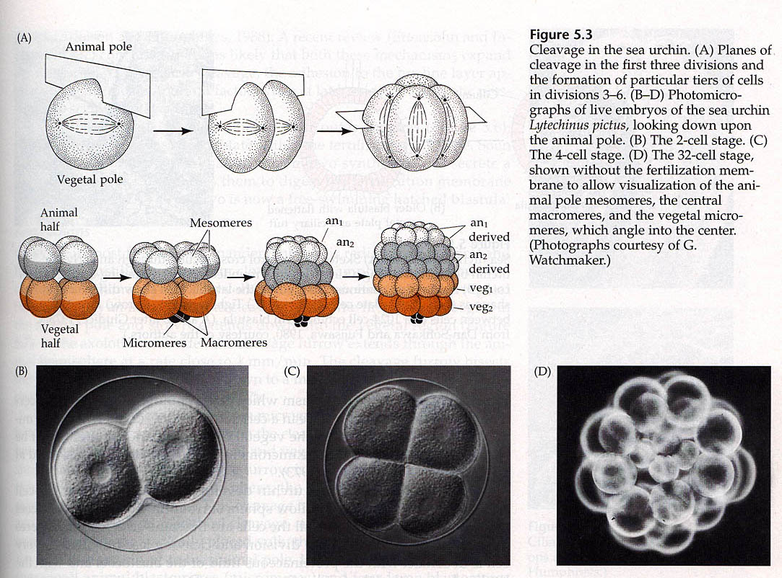
Cleavage and Blastomere
In all animal species known, differentiation begins by a process called cleavage, a series of mitotic divisions whereby the enormous volume of egg cytoplasm is divided into numerous smaller, nucleated cells. These cleavage-stage cells are called blastomeres.

Slide 10
What is the function of cell division or cleavage?
It generates different cells
How does cell division generate two different cells?
Unequal distribution of
cytoplasmic determinants
Unequal cell division
Cell-cell interaction
A
B
A
B
A
B

Slide 11
Three different types of embryo development
Mosaic Development (autonomous specification):
determined by local determinants and no cell-cell interaction
Experimental test: remove one blastomere, the blastomere still develop as it will be in the original embryo
2) Regulative Development (conditional specificaiton):
determined by cell-cell interaction and local determinants not important (e.g. mouse)
Experimental test: if remove one blastomere, the other blastomere will take over and the embryo is fine.
3) Intermediate (Xenopus, fly and C. elegans)

Slide 12
Cell-cell interaction affects cell fate determination
Intercellular long-range signaling (Wnt signalling in fly)
Intercellular short-range signaling
Intercellular relay signaling

Slide 13
Three different ways by which a target cell respond to a signal
Position (EMS and P2)
ABp
ABp
ABa
P2
ABa
P2
EMS
EMS
Time
    Concentration (Morphogen)
Morphogen
D
C
B
A
B
C
D

